Slide 1
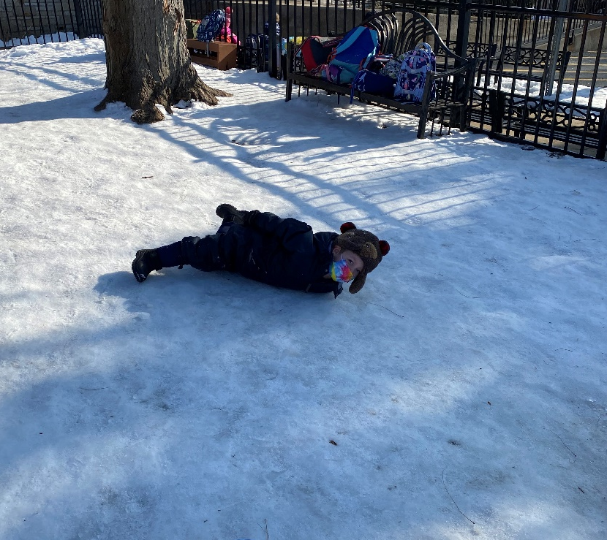
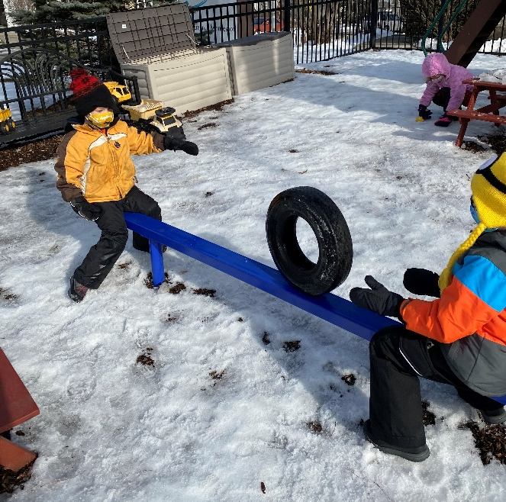
Winter Fun

Slide 2
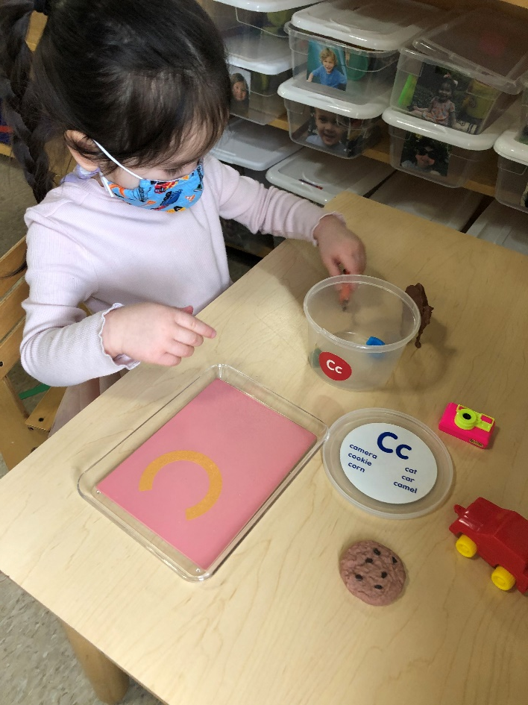
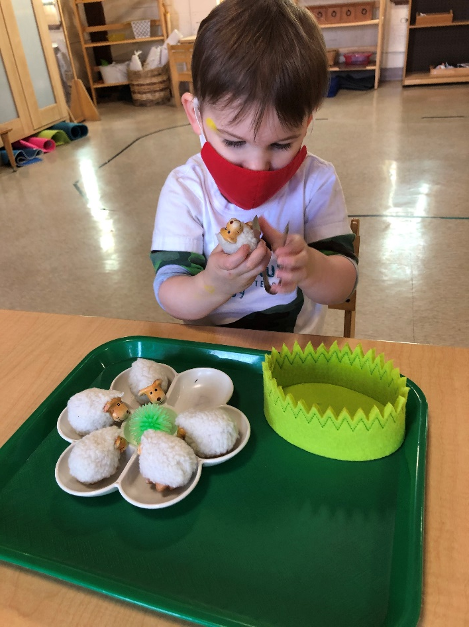
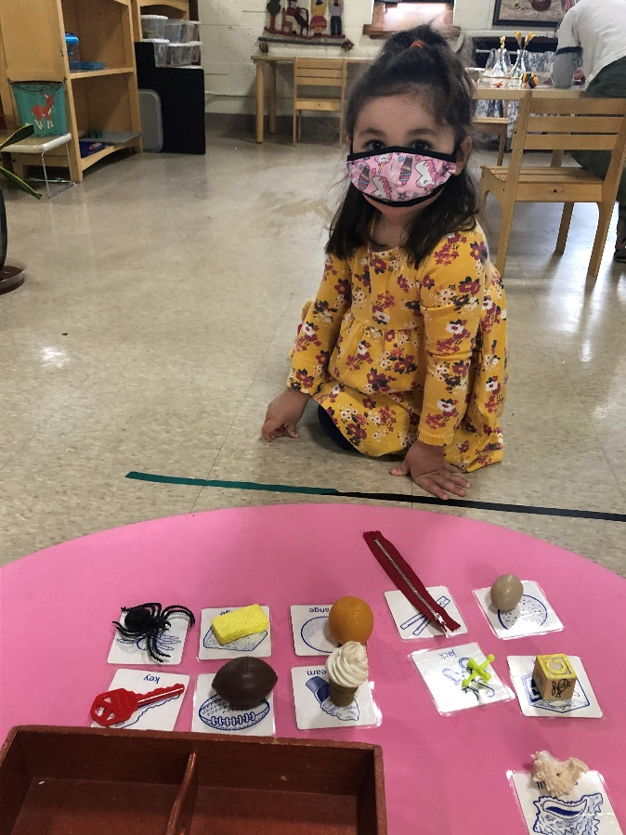
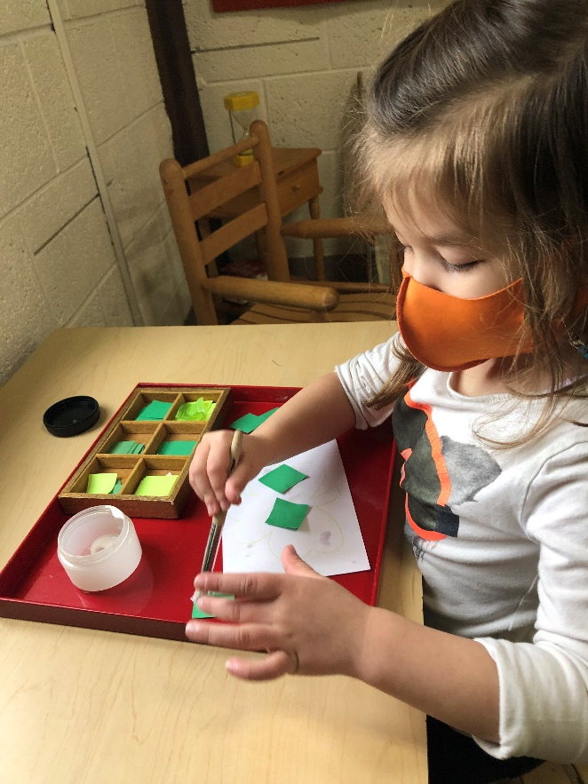
Toddler Class
Our toddlers are blossoming. It's so wonderful to see personalities emerge and concentration develop!
This month, we continue to explore science with a magnetic and non-magnetic work. They love finding
out what is magnetic in their environment! Chair scrubbing and dish washing continue to be a favorite.
We have been doing sandpaper letters with matching objects. This month, we are focusing on the sounds
m and a. We will celebrate St. Patrick’s Day with a song and do a ribbon dance and hope to have an
egg hunt soon. Have a wonderful Spring Break! - Ms. Maria

Slide 3
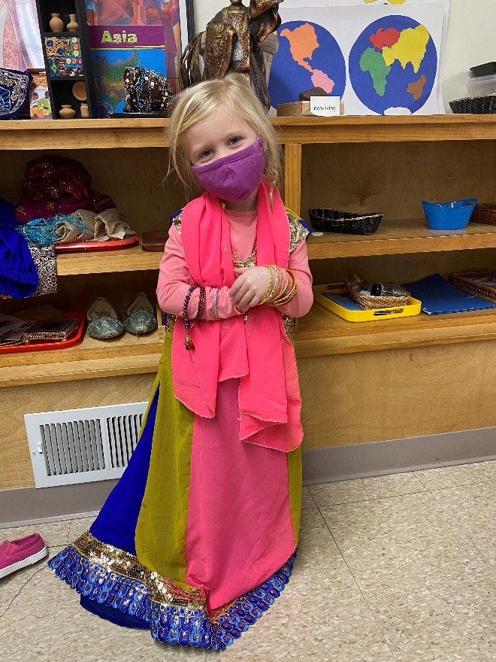
Pre-primary AM
Our Pre-primary and Enrichment Classes were able to combat the
winter blues by immersing themselves in Asian culture with Ms.
Nazia and Ms. Joan. Ms. Nazia shared her enthusiasm and love of
country by bringing in authentic clothing from India and Pakistan.
The children enjoyed wearing the beautiful sari’s, Shalwar Kurta’s,
jewelry, and shoes! Ms. Nazia also brought in a Gajra. A Gajra is a
flower garland worn during festive occasions which is made of
Jasmine and roses from Pakistan. Each child was given a piece of
the Gajra to take home!
Experiencing Authentic Asian Culture

Slide 4
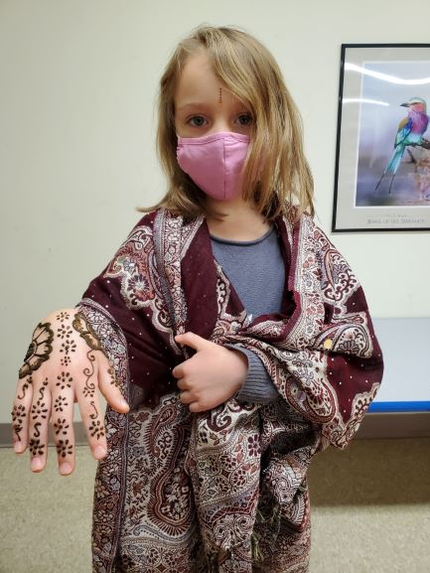
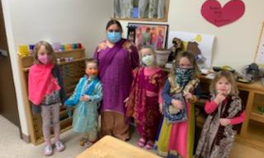
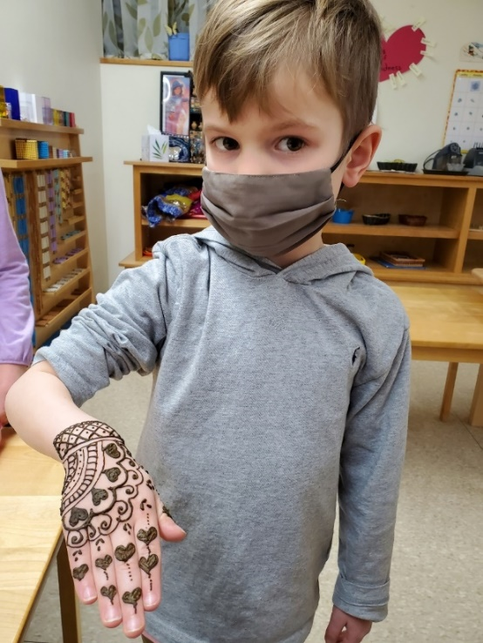
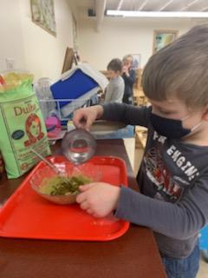
Pre-Primary PM/Enrichment
Perhaps the most exciting experience we had was getting beautiful Henna designs on our hands! We also got to mix our own Henna paste!

Slide 5
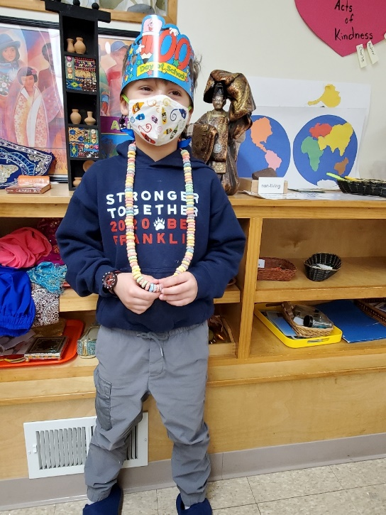
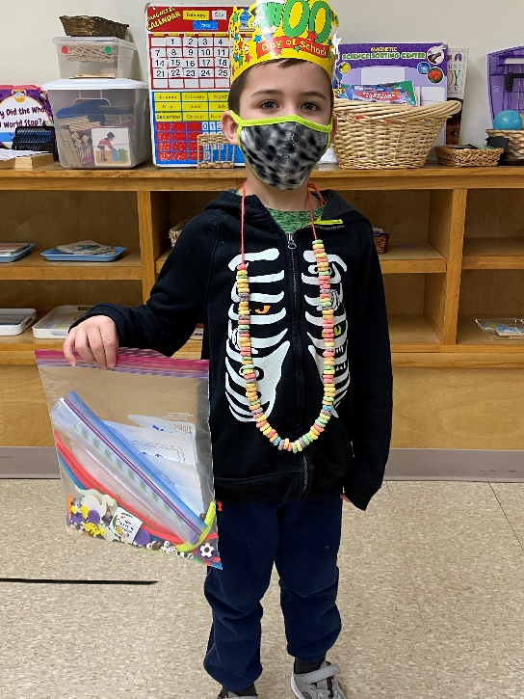
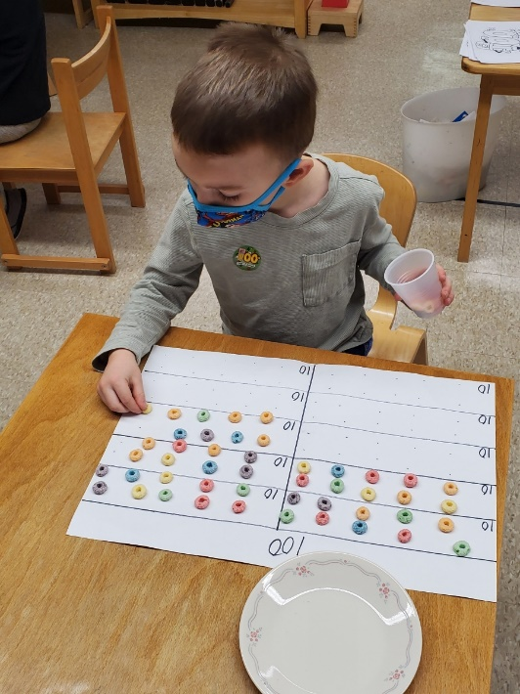
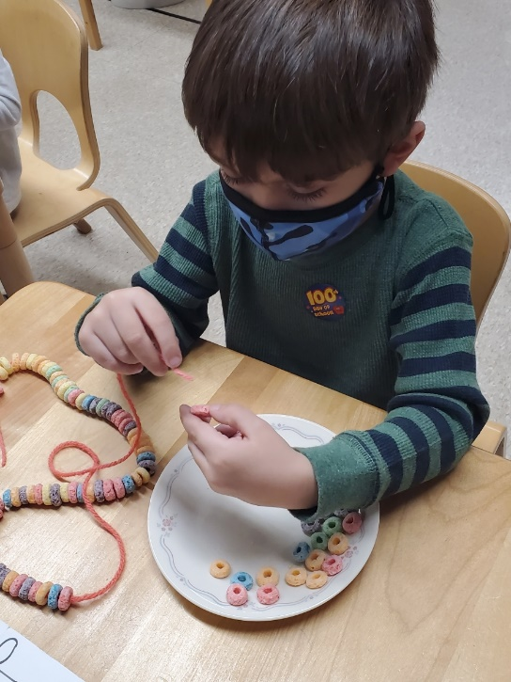
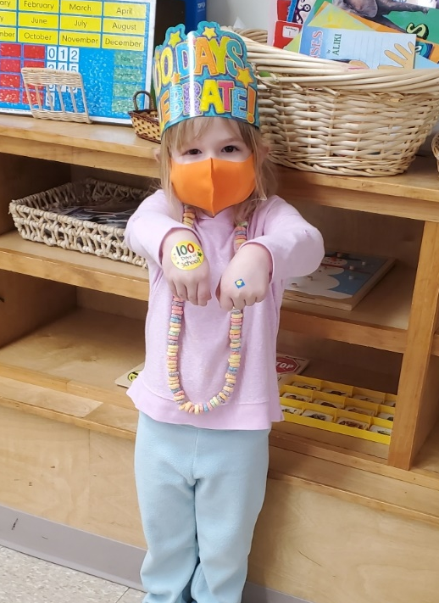
100 Day Celebrations
We celebrated our 100th day of school by counting by 10’s up to 100, sorting 10 rows of 10 items, stringing 100 fruit rounds on a string, and sticking 100 stickers to paper! Everyone picked 10 bags of 10 items and went home with a collection of 100 items! We even had time to perform 100 movements in a row; we clapped, jumped, wiggled, danced, etc. We went home EXHAUSTED after 100 Day!!!!!

Slide 6
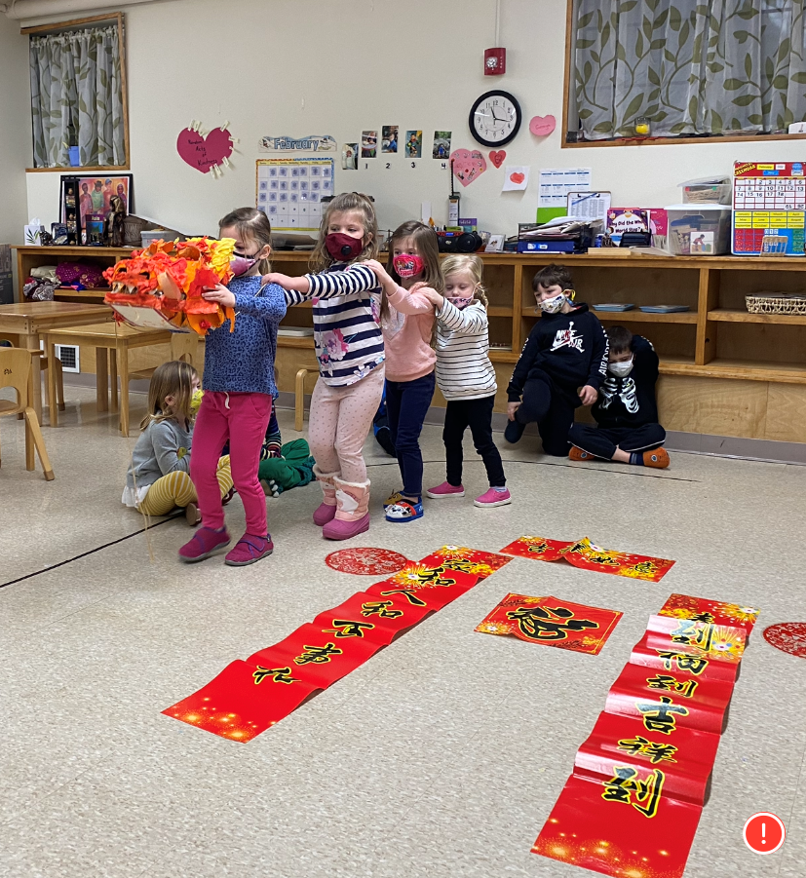
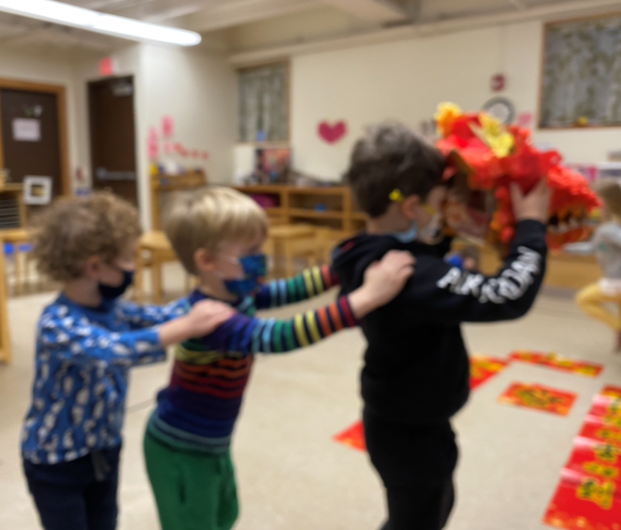
Chinese New Year
Ms. Joan taught us all about the Chinese New Year! We learned how to decorate our house in red and gold and to have oranges for good luck and prosperity in the new year. We made our own paper lanterns and danced the dragon dance with Ms. Maria’s homemade Chinese dragon!

Slide 7
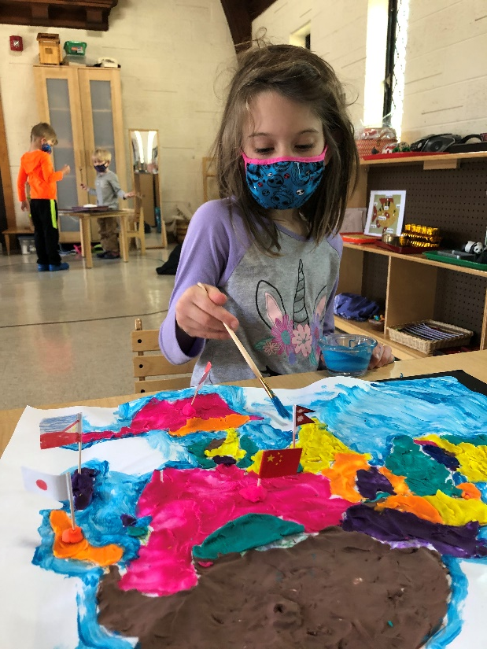
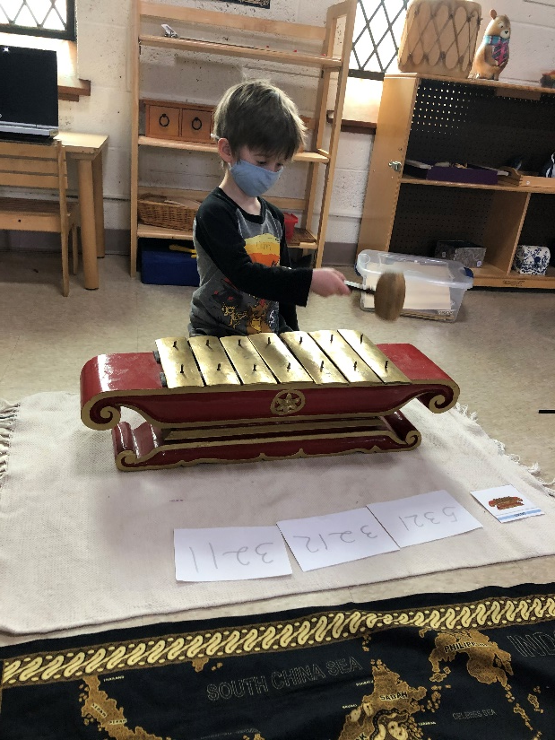
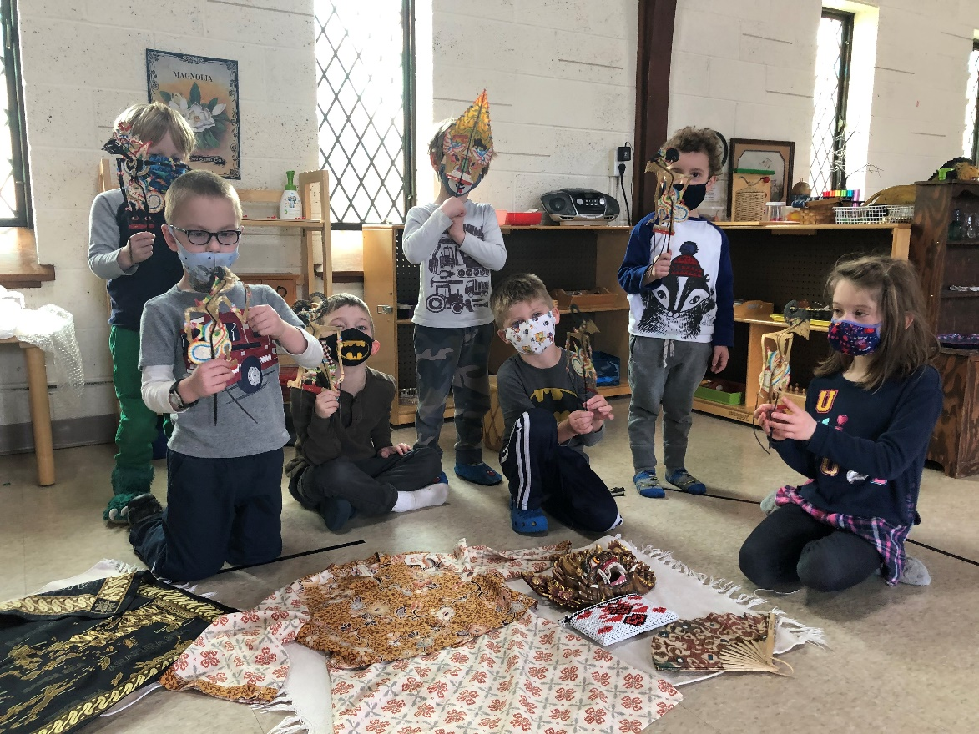
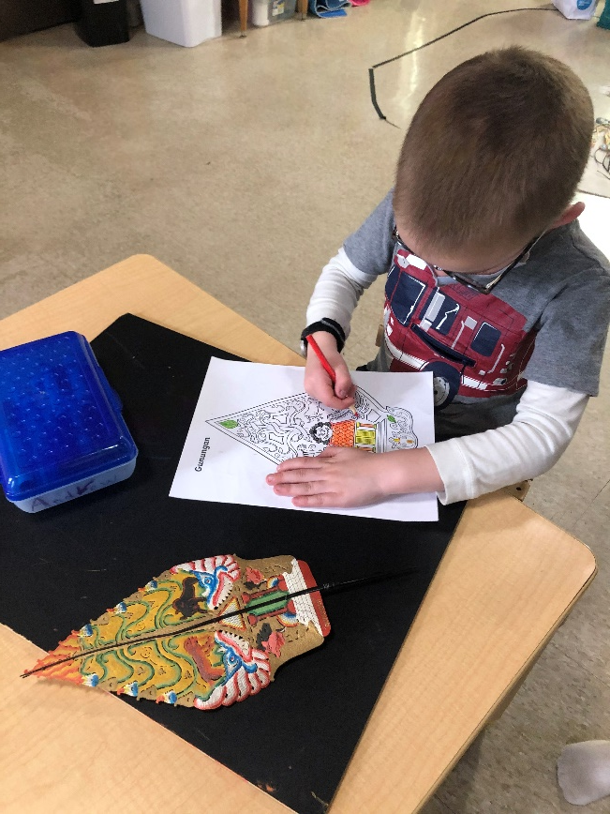
Full Day Fun
Our Full Day students have departed from their study of Japan and have landed on to our next Asian adventure: Indonesia. During our study of Japan, we practiced Taiko drumming with our bachi sticks while wearing a happi and made our own hachimaki (headband). We had a matcha tea ceremony and some of the girls got to dress up as geishas wearing yukata (casual kimono). We learned parts of the kimono. We finished our study by making Koinobori (Koi fish kites).
We have arrived in Indonesia and we are learning about various aspects of the Indonesian culture. We will compare the different clothing used in Java, Bali and Sumatra using 3-part cards and see samples of batik. We are learning all about the Gamelan orchestra in Java and we are listening to both Javanese and Balinese ensembles. We will learn the names of some of the gamelan instruments such as the gong, kempul and saron. We will practice playing on the instrument Saron, (on personal loan from the Friends of the Gamelan (FROG) of Chicago.) We will finish off with a study of Wayang Kulit (Shadow puppet theatre). The children have been very busy making their own puppets after seeing authentic wayang kulits. We will end our journey exploring different fruits from Indonesia such as the jackfruit and mangosteen. Selamat!
-Ms. Maria

Slide 8
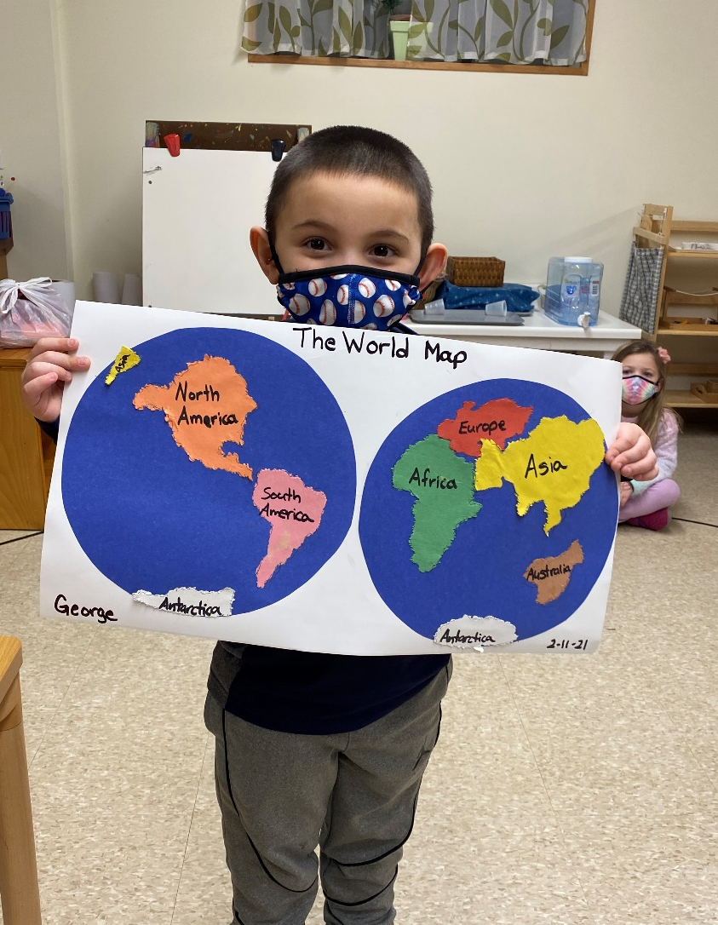
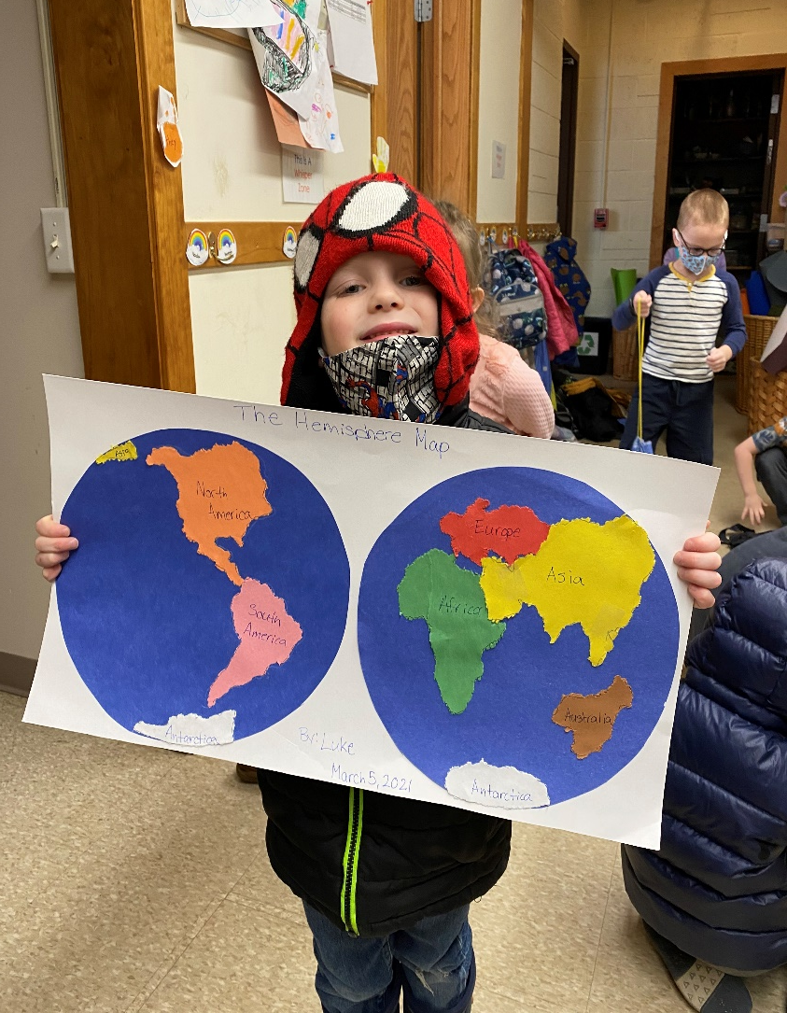
We love learning about our world!

Slide 9
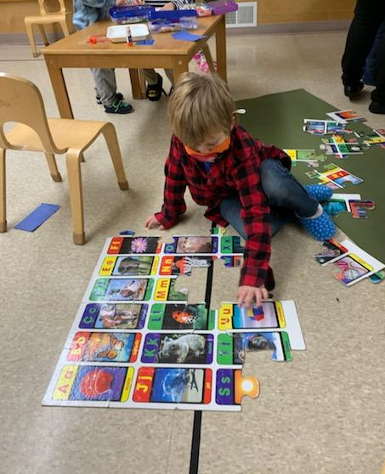
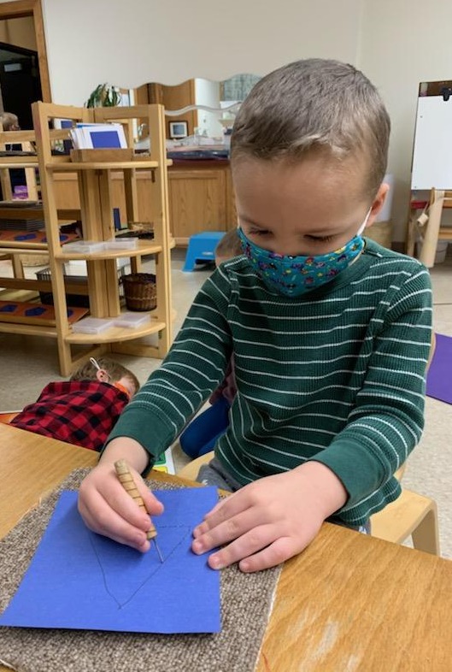
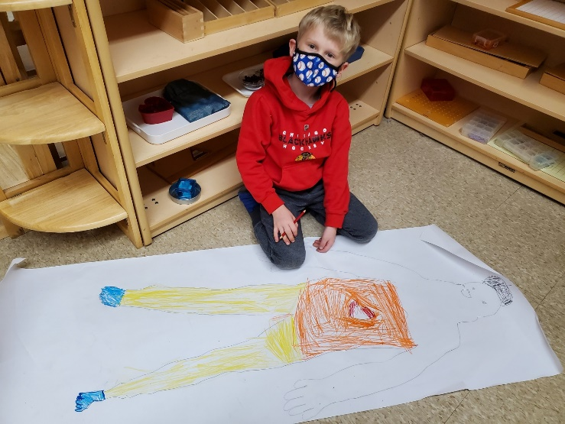
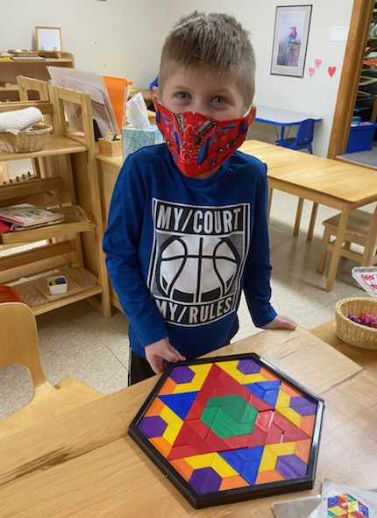
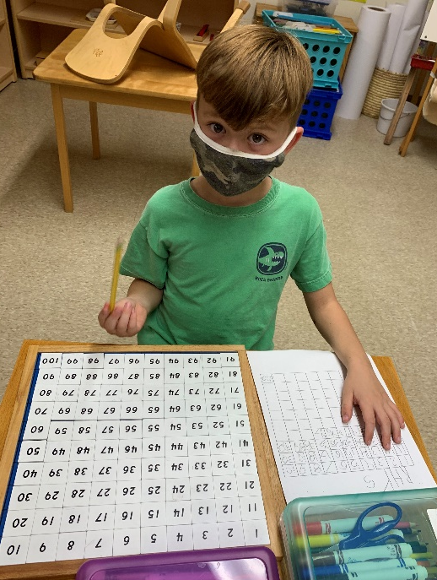
We love to work!

